Slide 1
8TH TECHNOLOGY AND INNOVATION INTERNATIONAL CONFERENCE (TECHON) 2025
‘AI, TVET, and Renewable Energy: Building a Sustainable Future in the Era of SDGs’
Poster Format:
Each poster must follow the following specifications:
Each participation MUST prepare ONE (1) poster.
The poster must be in A3 size (297mm x 420 mm).
The Poster must include the following mandatory sections:
Title of Research/Project/Innovation
Group Members/Institution
Introduction/Problem Statement
Research/Project/Innovation Objective
Methodology/Fabrication Methods
Results & Findings
Analysis & Implementation Level
Novelty and Inventiveness
Commercialization Potential
Intellectual Property (IP)
Participation can change the template design of the poster based on the creativity.

Slide 2
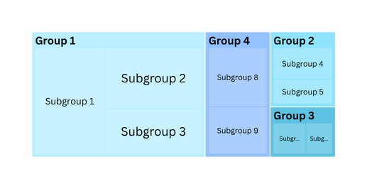
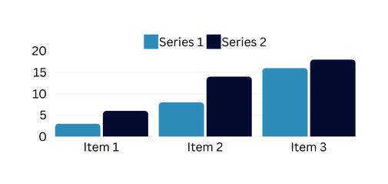
8TH TECHNOLOGY AND INNOVATION INTERNATIONAL CONFERENCE (TECHON) 2025
‘AI, TVET, and Renewable Energy: Building a Sustainable Future in the Era of SDGs’
RESEARCH TITLE
AUTHORS:
Author 1; Author 2; Author 3
AFFILIATIONS:
Name the institutions that support your research.
INTRODUCTION/PROBLEM STATEMENT
OBJECTIVE
Give some background information and A brief description of the problem or topic you are addressing. This gives your research context and lays the foundation for understanding the significance of your work. It also gives your study a distinct direction by clearly stating its goal and importance.
Explain the purpose of the study.
METHODOLOGY/FABRICATION METHODS
Describe the overall research strategy and the rationale for the approach chosen to address the research problem. State the following:
Participants/Sample
Materials/Instrument
Procedure
Data Analysis
Figure 1: Use this figure to support problem statement.
RESULTS & FINDINGS
ANALYSIS & IMPLEMENTATION LEVEL
Clear and concise presentation of the results is important. The results can be presented using tables, charts, graphs, or any other type of visual aid. Add brief textual explanations into the images which illustrate the significant findings. A reminder that while the images offer supporting evidence, the text should summarize the most important findings.
Table 1. Make sure you explain the data in the table.
NOVELTY AND INVENTIVENESS
Quality of being new or different from others. It can be a new idea, product or design.
COMMERCIALIZATION POTENTIAL
Figure 3: This space can be used to include another graph or table.
Commercial potential is the opportunity of commercialization of the candidate technology. Every new technology to reach market needs to thrive and prosper in a continuously changing and unpredictable business environment. Recommend to use graphical illustration.
INTELLECTUAL PROPERTY (IP)
Patents, Copyright, Trademark, Designs. Authors can also include the award from others innovation contest or proof of implementation from other parties.

