Slide 1


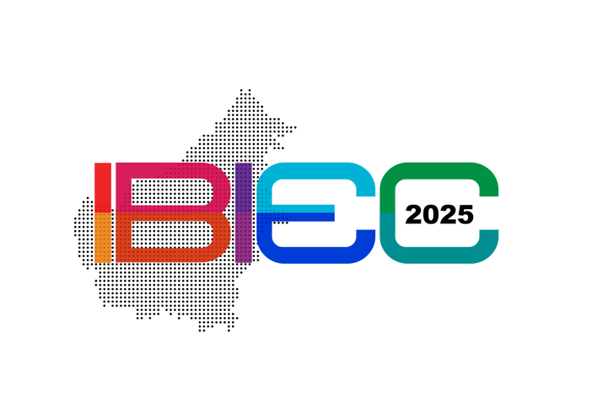

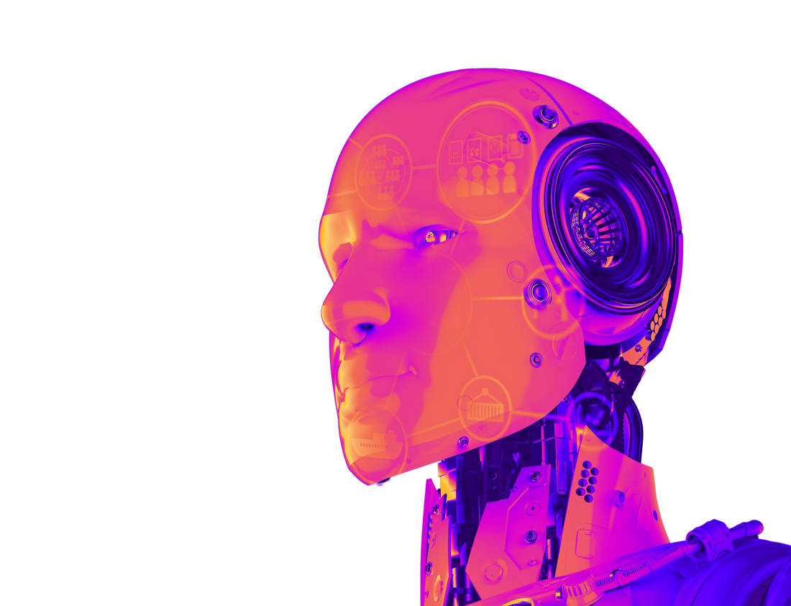
The International Borneo Innovation, Exhibition & Competition (IBIEC)
2025
GLOBAL INNOVATION SYNERGY: BRIDGING EDUCATION, AI, AND SUSTAINABLE TECHNOLOGIES
INNOVATION TITLE
AUTHORS:
Inventor 1; Inventor 2; Inventor 3
AFFILIATIONS:
Name the institutions that support your research.

